Slide 1

Title: eConsultation: Bridging Doctors and Patients
NeuroWeb (University of Botswana) – Theme B
CAVISTA HACKATHON

Slide 2

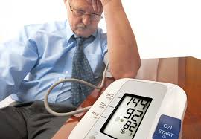
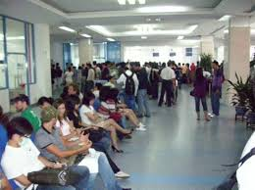

PROBLEM STATEMENT
30% of adults have hypertension, with only 9% controlled , a major risk for heart disease and stroke.[1]
5.8% of adults have diabetes.[2]
25% of adults have at least one chronic condition (e.g., hypertension, HIV, asthma).[3]
In Botswana, patients face long waiting times, and doctors struggle to access scattered patient records quickly, increasing the risk of misdiagnosis and reducing healthcare efficiency.

Slide 3
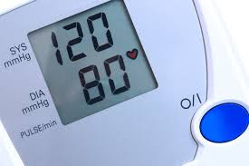
DEFINITION OF TERMS
What is Hypertension? A condition where the force of blood pushing against artery walls is consistently too high.
1️⃣ Systolic Pressure (top number)- measures pressure when the heart is beating (pumping blood).
2️⃣ Diastolic Pressure (bottom number)- measures pressure when the heart is resting between beats.
According to the World Health Organization: Normal BP is around 120/80 mmHg
Hypertension is diagnosed when:
  Systolic ≥ 140 mmHg and/or
  Diastolic ≥ 90 mmHg on multiple readings

Slide 4

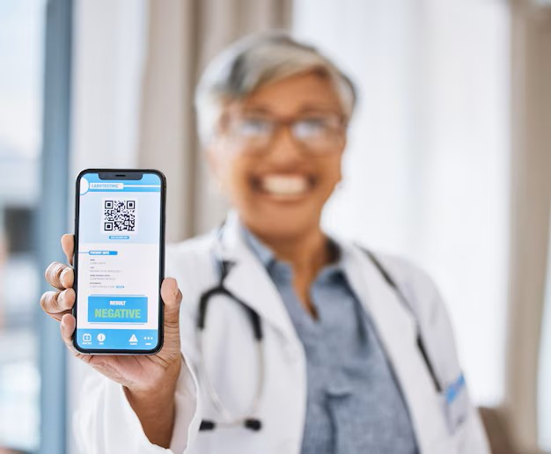
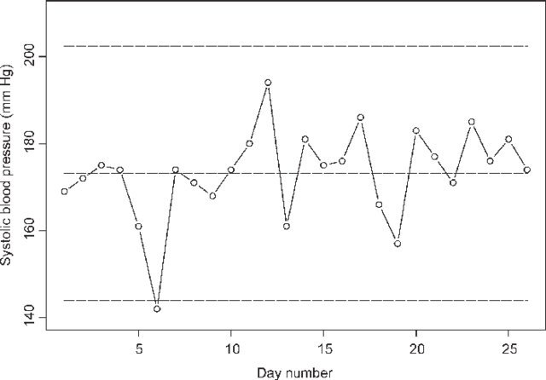
SOLUTION
Supports voice and text consultations, automatically transcribing conversations for accuracy and record-keeping
A highly secure online platform connecting doctors and patients in real-time (End to end encrypted)
Provide visual representation of data (seeing is believing)

Slide 5

IMPACTS AND BENEFITS
Reduce preventable deaths by providing timely access to medical advice
Increase healthcare efficiency by optimizing doctor-patient consultations
Track patient history digitally, improving follow-ups and treatment outcomes
Potential to scale nationwide, reaching even rural communities

Slide 6
REFERENCES
Tapela, N. M., Clifton, L., Tshisimogo, G., Gaborone, M., Madidimalo, T., Letsatsi, V., Masupe, T., Mosepele, M., Makhema, J., Lockman, S., & Hunter, D. J. (2020). Prevalence and Determinants of Hypertension Awareness, Treatment, and Control in Botswana: A Nationally Representative Population-Based Survey. International Journal of Hypertension, 2020, 8082341. https://doi.org/10.1155/2020/8082341
https://dailynews.gov.bw/news-detail/70283?utm_source=chatgpt.com
https://era.ed.ac.uk/items/68f470a2-9f5b-414e-8cf3-5ac64752c2c7

Slide 7
THANK YOU!!!

